Slide 1

Bright tv analysis
Power BI visuals

Slide 2
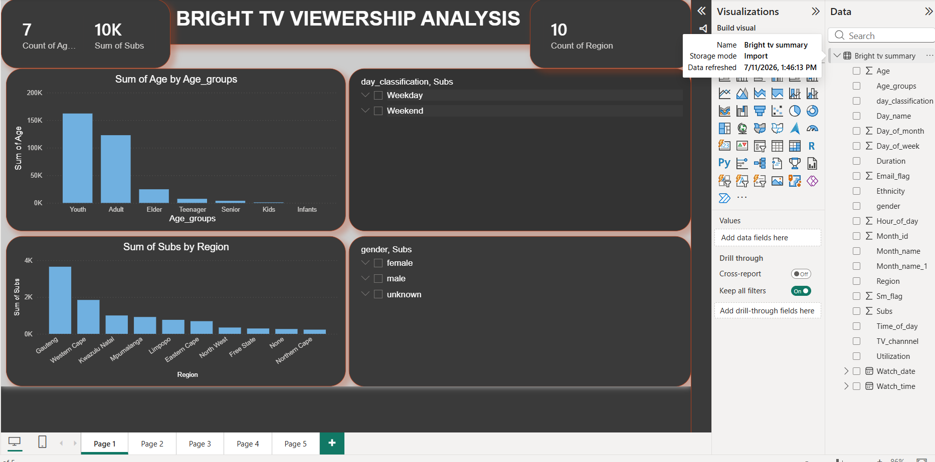
Age groups and Subs by region
There 7 Age groups, 10K Subs and 10 count of regions
Slicer for day classification to analyze which day classification has more views.
Slicer on gender to analyze which gender views the most between weekdays and weekends.

Slide 3
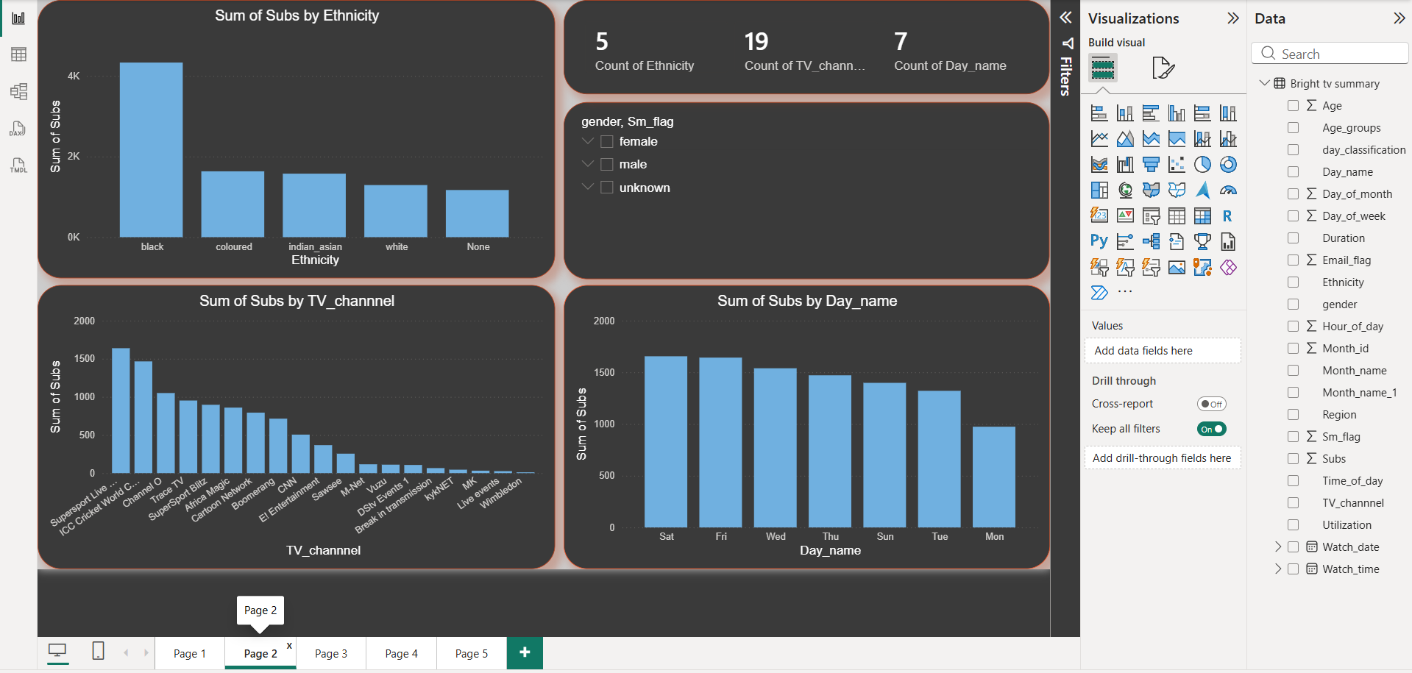
Ethnicity groups and Subs by channel
There 5 race groups, 19 channels and 7 count of day names.
Slicer on gender to analyze which gender views the most between day names and channels.

Slide 4
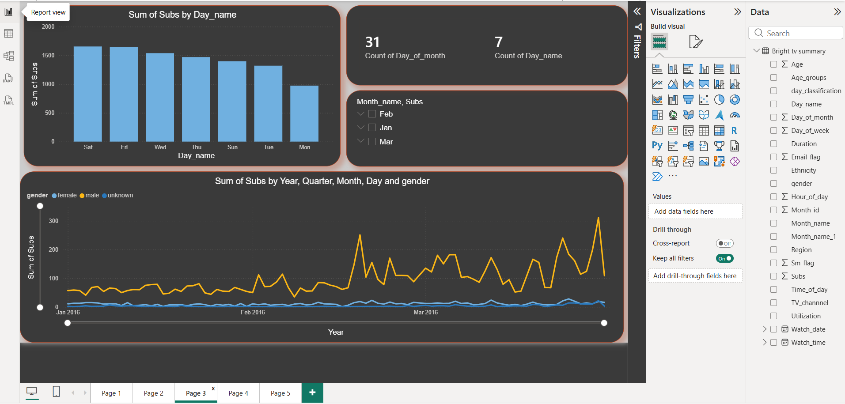
Subs viewing per day and most viewing gender p/m.
Count of days of month 31 and count of days per week which 7.
Month name slicer to analyze zoom in on a number of subscribers per day.

Slide 5
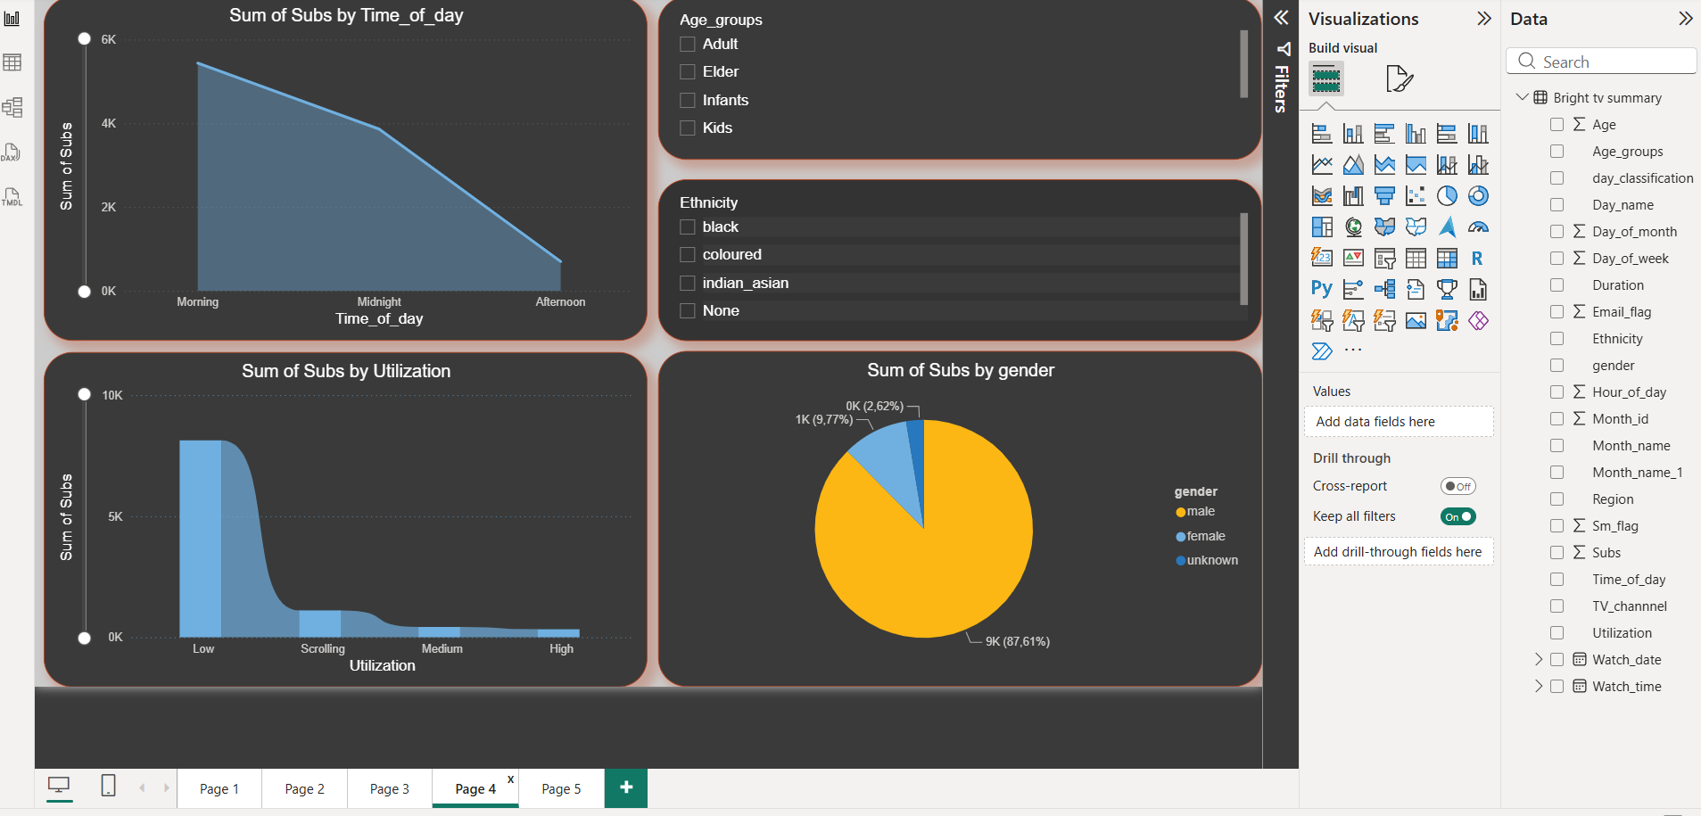
Subs by time of day and the utilization.
Slicer for age groups to analyze which group views and utilize the most.
Slicer on race to analyze which race utilize the tv and on which period of the day.

Slide 6
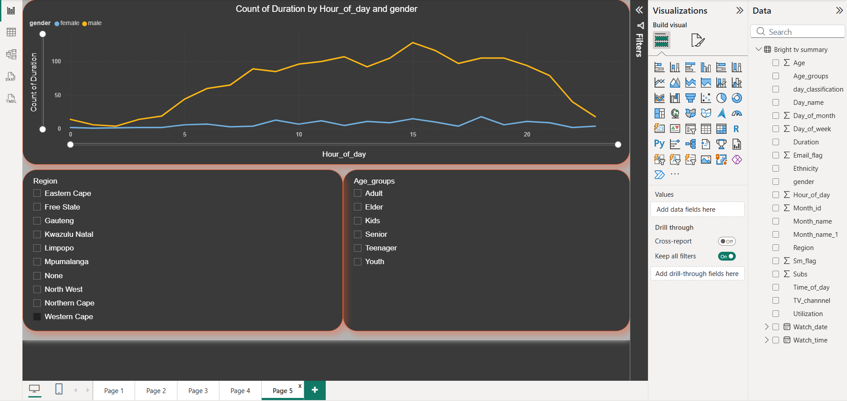
Count of duration by hour of the day and gender.
The slide is to show the peek hour regarding views and by which gender.
Slicer for region and age groups to analyze which Province uses the most or least television.

